Slide 1
CASE STUDY ON E-COMMERCE BUSINESS DEVELOPMENT
Done By
Name -> Vadthya Aniketh
Roll number -> 19EC10069
FOUNDATIONS OF ENTREPRENEURSHIP SPRING 2022
Git hub link :

Slide 2
MARKETING GOAL :-
Based on our initial analysis of the project and multiple meetings with the client, we finalized the following goals for the marketing projects:
Optimize the online website to increase visibility and make it friendly to users as well as search engines;
Increase the leads and sales to the business.
Improve the overall business reputation in the industry.

Slide 3
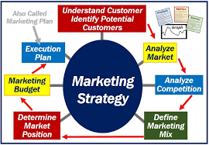
MARKETING STRATEGY :-
ON PAGE SEO :
Website redesigning/development
Quality Content creation & optimisation
Keyword research and placement
Meta tags optimization
Layout optimization (Mobile-friendliness, etc.)
Internal & External linking
Blog development
Loading speed optimization
Other elements – images, multimedia, URL, etc.

Slide 4
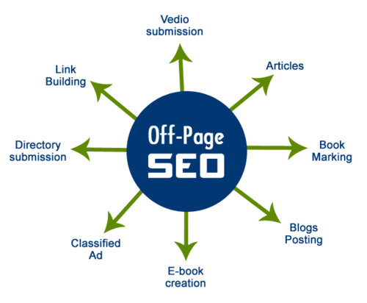
OFF PAGE SEO :
Content Marketing
Blog posting on the website
Regular content creation and off-site posting
Social media marketing
Paid Advertisement
Email marketing
Influencer Marketing
News and PR Marketing
Video Creation & Posting
Questions & Answers Activity

Slide 5
CONTENT OPTIMIZATION :
New content was created for each of the pages (products, categories, etc.) as well as for the homepage of the website. We placed all the relevant keywords at all the right places in the content to ensure that search engine bots can easily identify them and rank accordingly.
INTERNAL AND EXTERNAL LINKING :
To make it easier for users to browse the content and find products on the site, we interlinked all the important and relevant pages with each other as well as to the homepage. We also added a search option in the header part for optimal user experience.

Slide 6
Off-Page SEO (Marketing):
After the website development & optimization were done, we moved on to the off-page marketing part. The job was assigned to a team of seasoned digital marketers with expertise in SEO, SMO, content marketing, and other off-page things.
We created and posted relevant, high-quality articles and blogs across top blogging sites on the internet in order to build a strong presence of the business in the online space, helping those who are looking for information or recommendations for buying natural, organic clothing in Sweden.

Slide 7
Email Marketing:
Through a thorough analysis of the target market and customers, we prepared an email list of all the potential and existing customers of the brand. We used that list for direct marketing of the brand products and offers by sending customized emails and messages to the users.
Influencer Marketing:
For the promotion of the business and products on YouTube, we took the help of one or two industry influencers for getting the word out about a new launch or offer through specialized videos.
News And PR Marketing:
We regularly published updates about new launches and offers by Wear&Smile on many popular news and PR (press release) sites as well as on the company blog.

Slide 8
THANK YOU

